Slide 1

PUBLIC TRANSPORT
OPTIMIZATION

Slide 2
TEAM DETAILS
MEESALA PRAVEEN (MEMBER)
PRABU
(MENTOR)
THIYAGARAJAN
D (MEMBER)
PUBLIC
TRANSPO
—RT
OPTIMIZA-
REVU BHARATH KUMAR (LEADER)
MUSALI DIVAKAR (MEMBER)
SUDHAKAR V
(MEMBER)
-TION

Slide 3
PROJECT DEFENITION :
The project involves integrating IOT sensors into public transportation vehicles to monitor
ridership monitoring.
To track locations and predicts arrival times.
The goal is to provide real time transmit information to the public through a public platform
enhancing the efficiency and quality of public transportation services.

Slide 4
PROJECT OBJECTIVES :
This projects includes defining objectives designing the IOT sensor system, developing the IOT sensor system, developing the real time transit information platform, integrating using IOT technology and python.
This project main aim is to find a set of routes, each assigned to a vehicle by using IOT sensor
system technology.
This optimization can help to track the moving object in real time and minimize the cost of user incentives.

Slide 5

DESIGN THINKING :
IOT sensor design;
Real –Transit information
platform;
Integration approach;

Slide 6
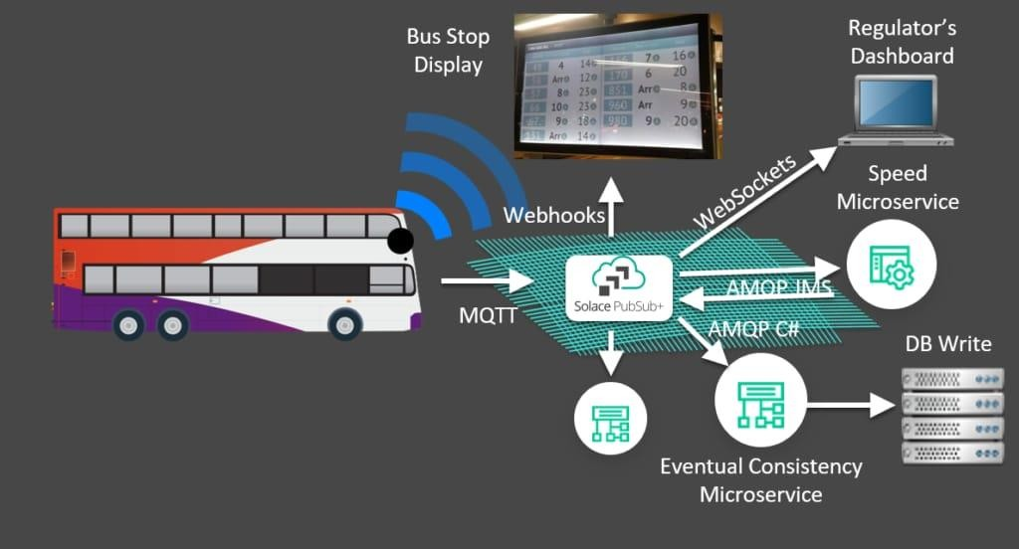
IOT SENSOR DESIGN :
We use GPS(Global Positioning System) sensor is used for tracking the bus.
The GPS are used for tracking the precise location of buses in real time.
From the sensor, we analyse the location and send the data to other platform like websites.

Slide 7

REAL TRANSIT INFORMATION PLATFORM :
We need to create a website that accepts
our GPS data’s.
We need to create a website using javascript code and that code receives and process the sensor data sent from frontend.
We need a database storage system to store the data.

Slide 8
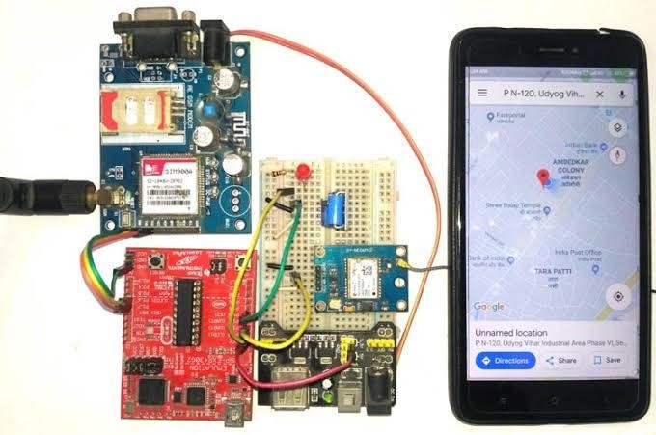
INTEGRATION APPROACH :
To merge GPS sensor data into a website, we use javascript to fetch and display the data directly in the web browser.
We can use web application and the web app is accessed through a web browser and runs on web server.
Throughout the testing our website to ensure that it is accurately display our data.

Slide 9


